Slide 1

Geldium Collections: AI-Powered System Briefing
August 21, 2025
A comprehensive overview of our new AI-powered collections system designed to identify at-risk customers, implement targeted interventions, and continuously improve through machine learning.

Slide 2



How the System Works: Inputs & Decision Logic
Inputs
Comprehensive customer data including demographics, detailed payment history, credit scores, utilization, and other financial indicators
Decision Logic
Robust predictive model (Gradient Boosting) analyzes inputs to identify at-risk customers, assess delinquency probability, and categorize risk levels

Slide 3


How the System Works: Actions & Learning
Actions
Learning
Automated communication (SMS, email) for initial alerts
System continuously monitors intervention outcomes, creating a feedback loop that updates the AI model, refining predictions and optimizing strategies over time
Targeted interventions for high-risk segments
Human agent alerts for complex cases
For high-risk segments (e.g., 'Business' cardholders with 2+ missed payments), the system recommends financial literacy programs, tailored payment plans, or counseling.

Slide 4

Role of Agentic AI
Autonomous Activities
Human Oversight Activities
Real-time risk scoring and customer segmentation
Review and approval of high-impact intervention strategies
Automated initial communication and reminder delivery
Handling complex customer queries and emotional support
Proactive identification of early delinquency indicators
Ethical auditing, bias detection, and model calibration
Standardized data preprocessing and feature engineering
Appeals process and personalized financial counseling

Slide 5
Responsible AI Guardrails
Fairness Auditing
Explainability (XAI)
Regular, systematic fairness audits across demographic subgroups (age, income, credit card type, location) to detect and mitigate any disproportionate impacts or biases
Utilize explainable AI techniques (e.g., SHAP values) to provide transparent insights into model decisions, ensuring customers and regulators understand the basis of risk predictions
Compliance & Privacy
Human-in-the-Loop Oversight
Strict adherence to relevant financial regulations (FCRA, fair lending laws) and robust data privacy standards (GDPR), ensuring secure and lawful data handling
Human oversight at critical decision points, especially for sensitive or complex cases, allowing for human judgment, intervention, and an appeals process

Slide 6
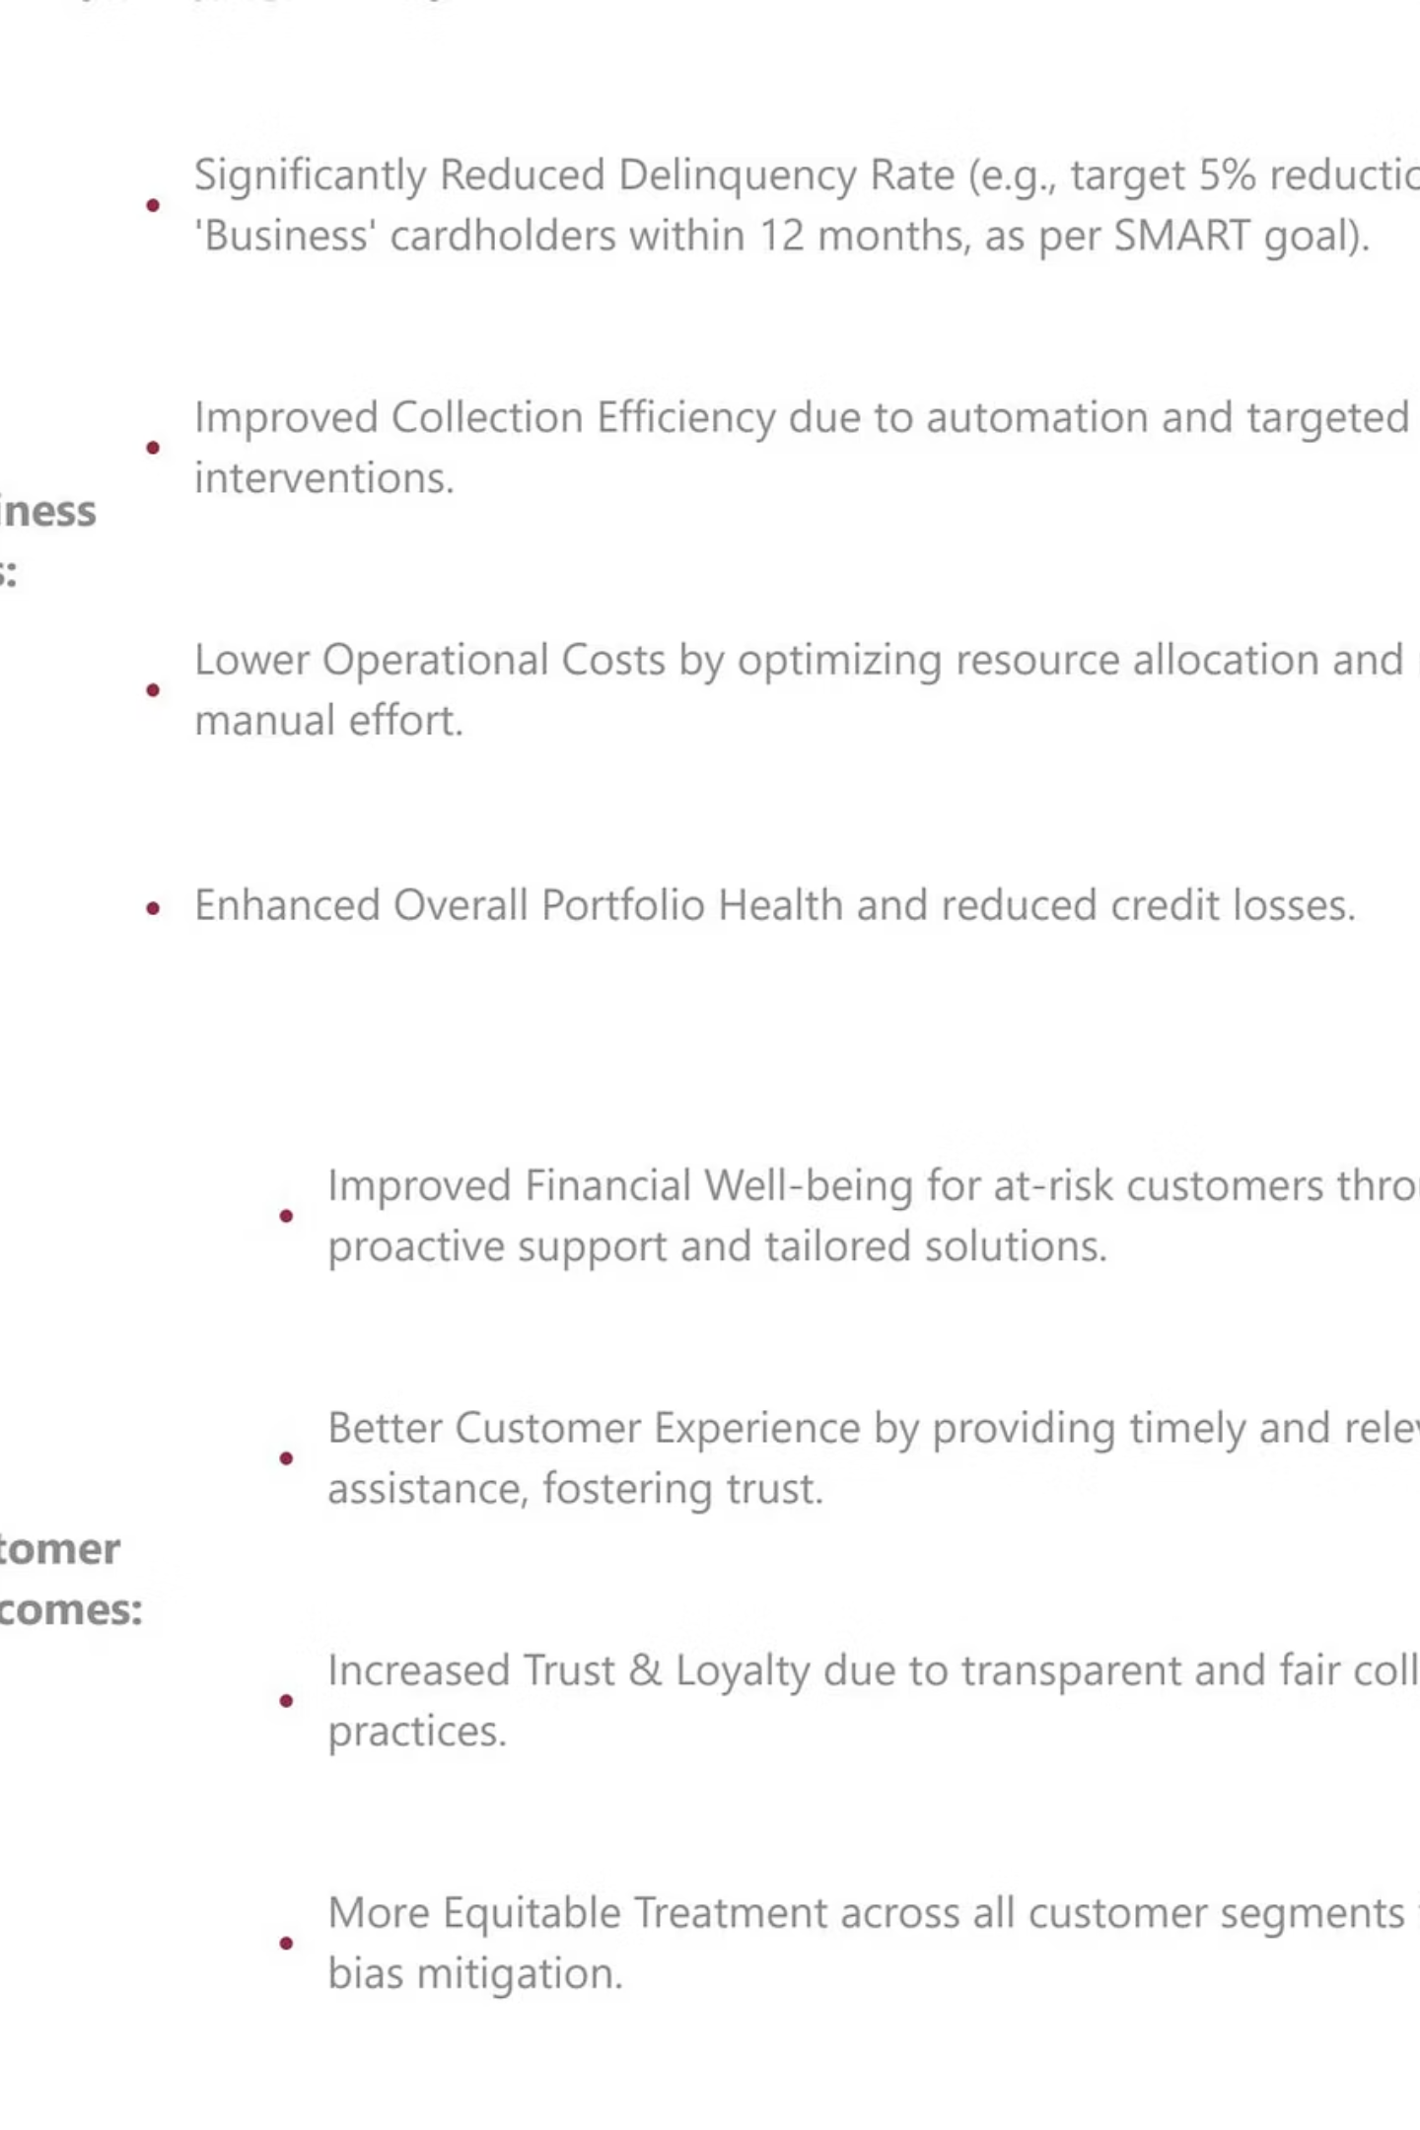
Expected Business Impact
Our AI-powered collections system is projected to deliver significant improvements in delinquency rates, operational efficiency, and customer satisfaction while maintaining regulatory compliance.

Slide 7
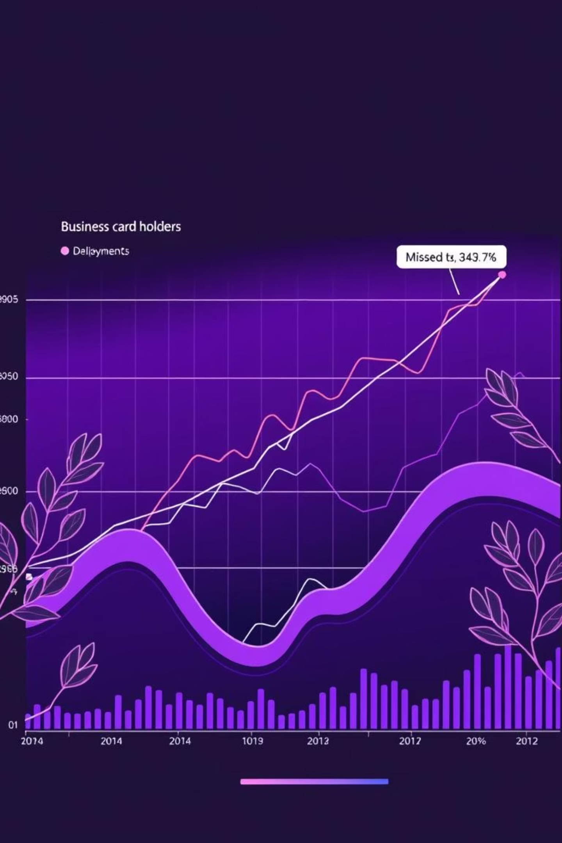
Key Insights from Previous Analysis
Top Risk Factors
High frequency of late/missed payments
'Business' credit card types
'Unemployed' employment status
Strategic Application
These insights are foundational to the AI system's decision logic and targeted interventions, allowing for precise risk assessment and customized approaches

Slide 8

Handling Missing Data
Challenge
Solution
Missing values in critical fields:
Median imputation was implemented to address missing data points
Income
Credit Score
This approach:
Loan Balance
Maintains data accuracy
Prevents skewed analysis
Preserves predictive model integrity

Slide 9


Strategic Intervention Focus
SMART Goal
5% delinquency reduction for 'Business' cardholders with 2+ late/missed payments within 12 months
This focused strategy leverages the predictive power of the AI model to address the most impactful risk segment effectively.
Identify
Target 'Business' cardholders showing early warning signs
Intervene
Deploy customized financial literacy and payment plans
Measure
Track delinquency reduction against 5% target

Slide 10
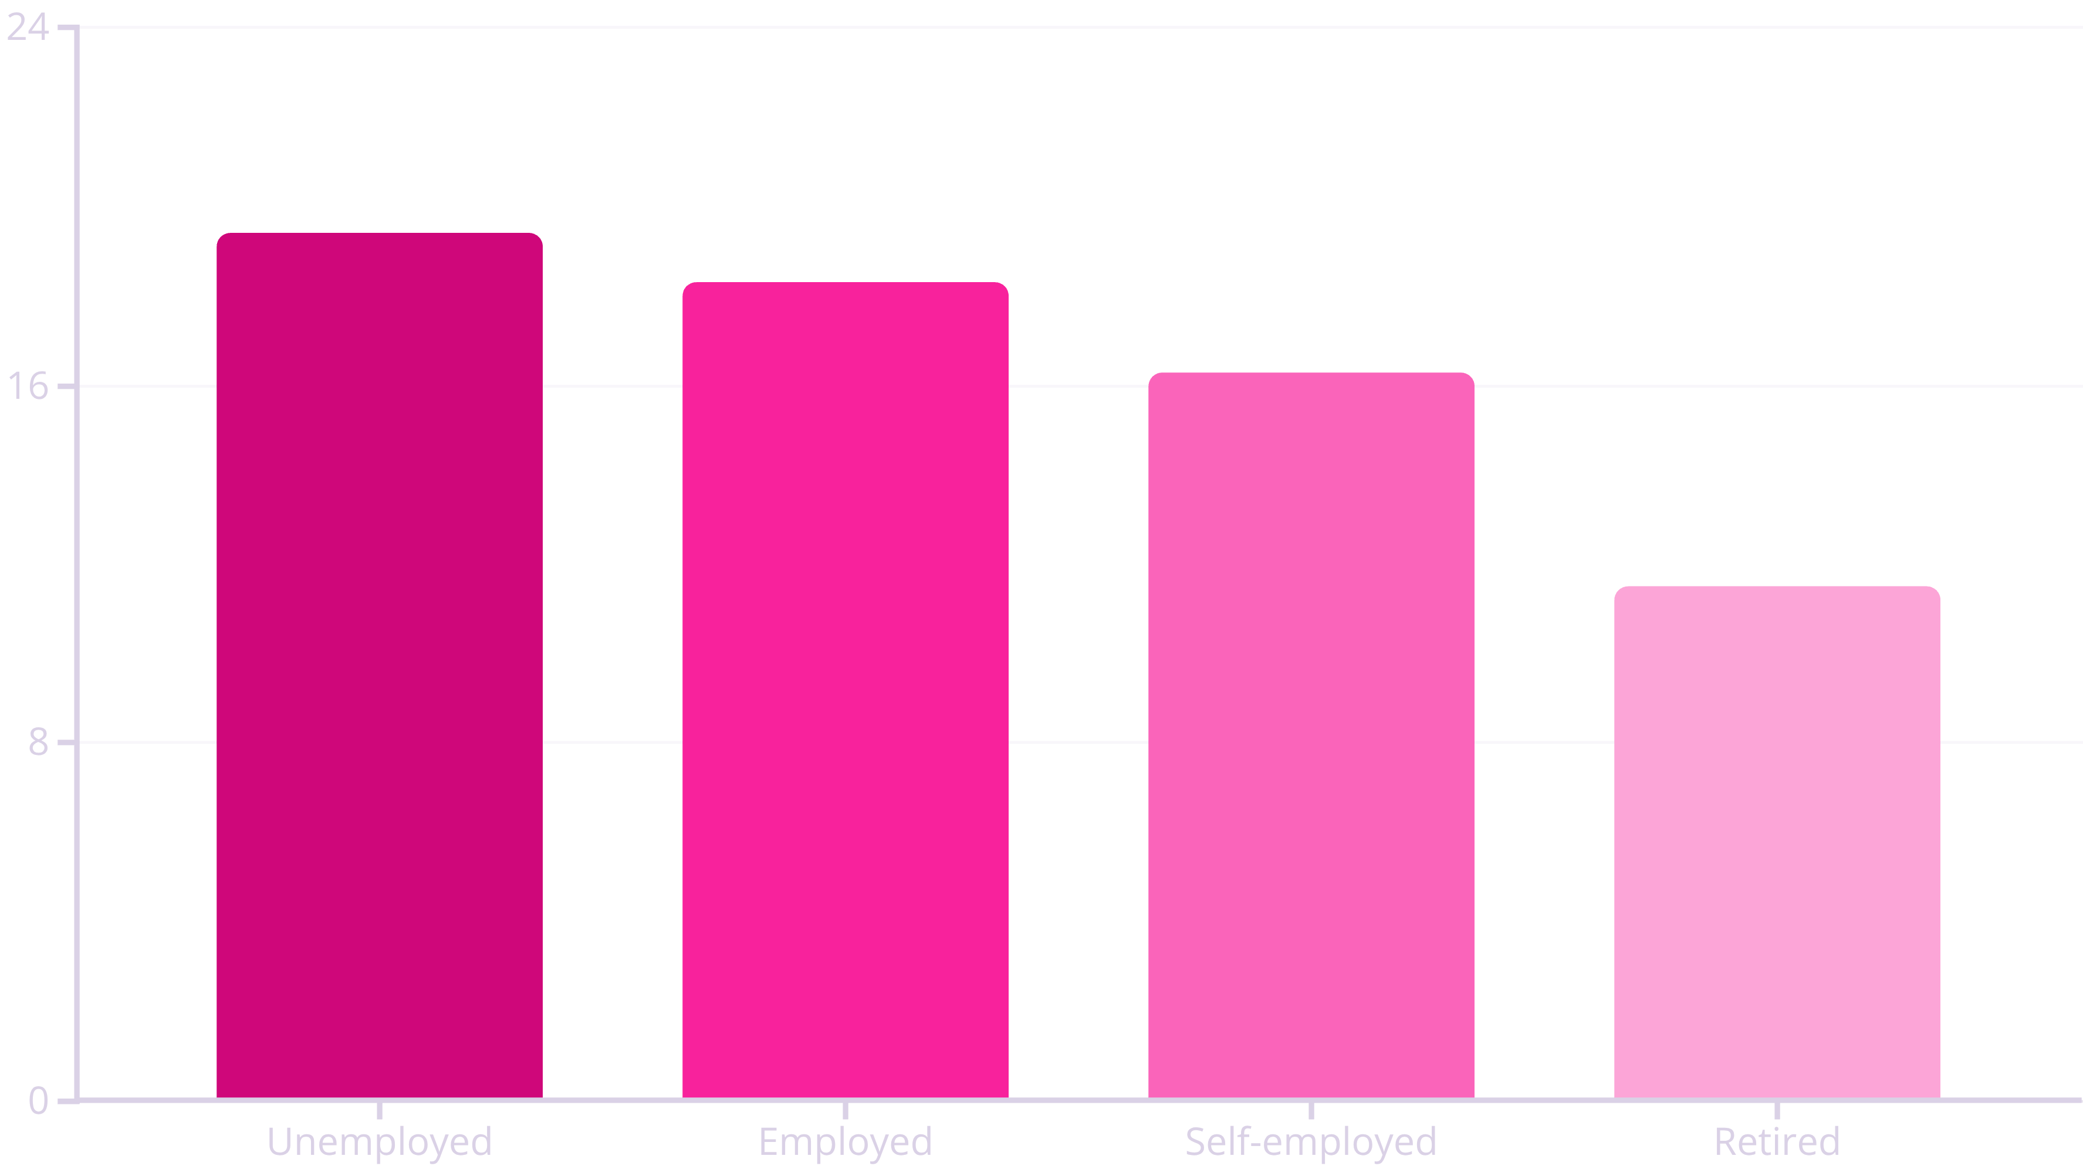
Employment Status Risk Segmentation
Unemployed customers show the highest risk (19.4%), while retired customers demonstrate the lowest delinquency rate (11.5%).
Unemployed customers show the highest risk (19.4%), while retired customers demonstrate the lowest delinquency rate (11.5%).

Slide 11
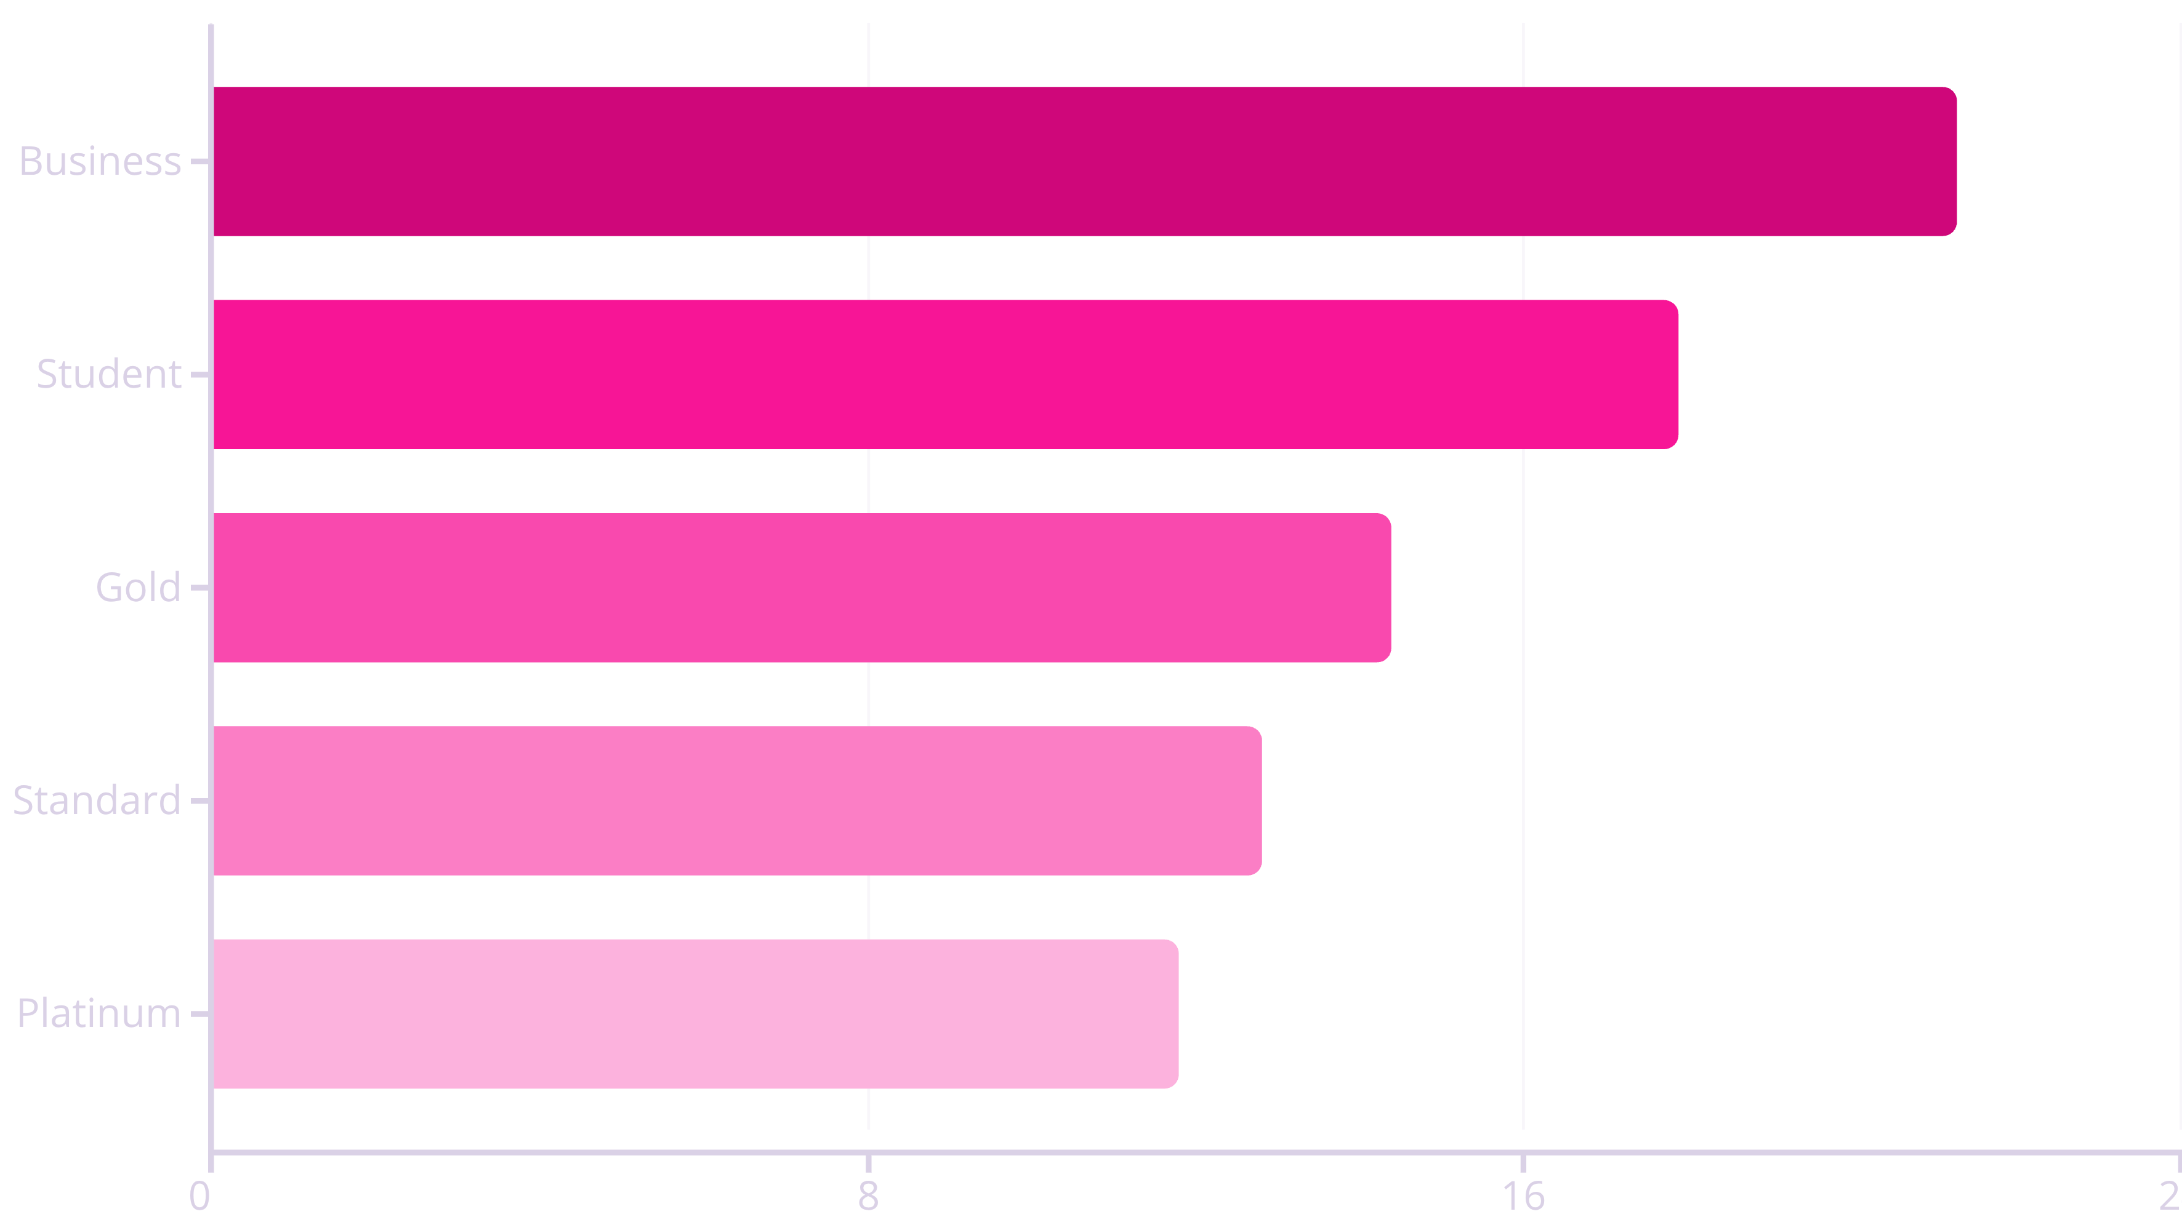
Credit Card Product Risk Profile
Business Cards show the highest risk (21.3%), while Platinum Cards demonstrate the lowest delinquency rate (11.8%).
Business Cards show the highest risk (21.3%), while Platinum Cards demonstrate the lowest delinquency rate (11.8%).

Slide 12
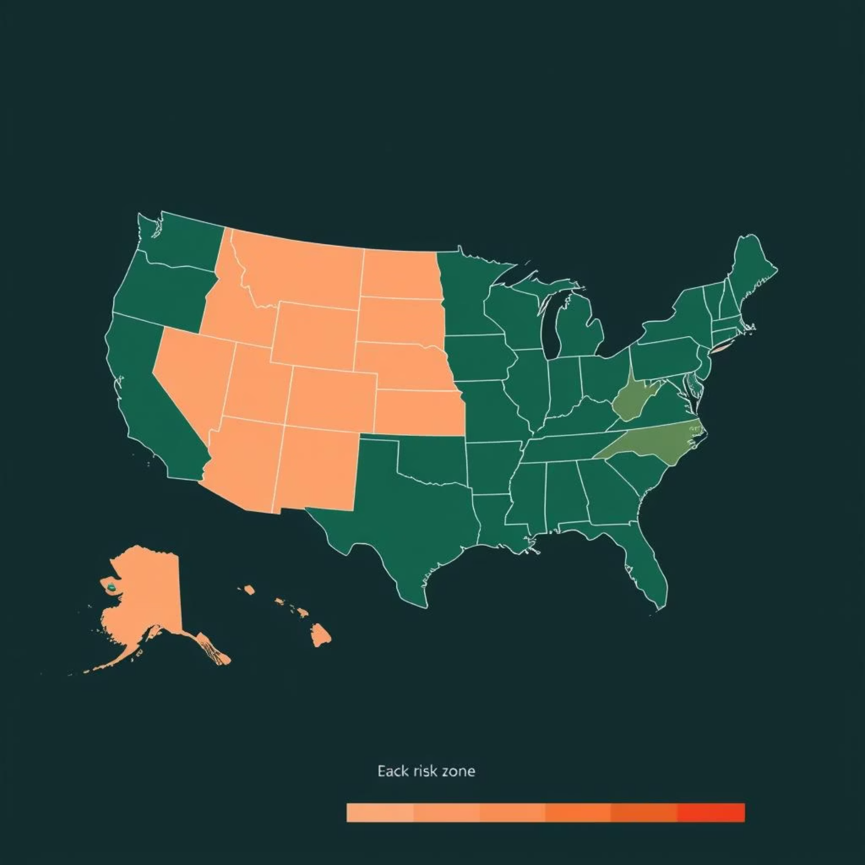
Geographic Risk Distribution
Los Angeles
19.6% delinquency rate (highest)
Houston
16.8% delinquency rate
Phoenix
16.5% delinquency rate
Chicago
14.6% delinquency rate
New York
12.0% delinquency rate (lowest)
Location-based analysis shows significant regional variations in delinquency risk, with Los Angeles having the highest rate and New York the lowest.

Slide 13

Model Performance Results
Model
Overall Accuracy
Precision (Delinquent)
Recall (Delinquent)
F1-Score (Delinquent)
Logistic Regression
84%
0%
0%
0%
Decision Tree
67%
13%
19%
15%
Neural Network
80%
17%
6%
9%
Critical Issue: Class imbalance (84% non-delinquent vs. 16% delinquent) causes models to optimize for overall accuracy rather than effectively identifying high-risk customers.

Slide 14

Next Steps
1
Phase 1: System Integration
Connect AI model with existing customer databases and communication channels
2
Phase 2: Pilot Program
Launch targeted intervention for 'Business' cardholders with 2+ missed payments
3
Phase 3: Evaluation
Measure impact against 5% delinquency reduction goal
4
Phase 4: Full Deployment
Expand system to all customer segments with continuous improvement

Slide 15
THANK YOU
GET IN TOUCH
Github : https://github.com/dhanuda26/TATA-iQ-Internship-Project.git
LinkedIn : www.linkedin.com/in/dhanasekaran-mohanraj-da

